Slide 1


Data Structures
ETCCDS202
Dr. Aarti
Faculty
School of Engineering & Technology
K.R. Mangalam University
Unit 2 : Linear Data Structures

Slide 2

Unit-2 Linear Data Structures
SESSION 11 Arrays – 1D & 2D
SESSION 12 Static & Dynamic Arrays
SESSION 13 Linked Lists Types
SESSION 14 Linked List Operations
SESSION 15 Stack ADT & Operations
SESSION 16 Stack Applications
SESSION 17 Queue ADT
SESSION 18 Queue Applications
SESSION 19 BFS using Queue
SESSION 20 Revision (Unit–2)
Notes:
New Courses replaced with New Programmes

Slide 3
Linked List Operations
Session 14
Introduction to Linked List Operations
Singly Linked List Representation
Traversal Operation
Insertion Operations
Deletion Operations
Search Operation
Advantages and Disadvantages
Key Takeaways
Quick Quiz
References
Notes:
New Courses replaced with New Programmes

Slide 4
Learning Objectives
After this lecture, students will be able to:
Explain basic operations performed on a linked list
Perform traversal, insertion, deletion, and search operations
Write and understand algorithms and code for linked list operations
Analyze time complexity of different linked list operations
Identify common errors while performing pointer manipulations
Notes:
New Courses replaced with New Programmes

Slide 5
Recapitulation (Linked List Types)
A linked list is a linear data structure made up of nodes, where each node contains data and pointer(s).
The head points to the first node, and the last node points to NULL (except in circular lists).
Singly linked list: One pointer; forward traversal only.
Doubly linked list: Two pointers; forward and backward traversal.
Circular linked list: No NULL pointer; last node points to head.
Linked lists: Dynamic memory with efficient insertion and deletion.
Notes:
New Courses replaced with New Programmes

Slide 6
Quick Quiz
A linked list is composed of a series of connected __________.
Each node of a singly linked list contains __________ pointer(s).
In a circular linked list, the last node points to the __________.
A doubly linked list supports __________ traversal.
Linked lists store elements in __________ memory locations.
Pointer to the first node of a linked list
Notes:
New Courses replaced with New Programmes

Slide 7
Linked List Operations
The basic operations on a linked list are:
Traversal: Visiting every element and displaying it
Insertion: Add a new element to the list- beginning, end, after another node
Deletion: Removing an item from a list- beginning, end, after a given node
Search: The supplied key is used to search element
Notes:
New Courses replaced with New Programmes

Slide 8
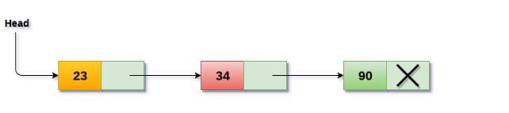
Singly linked list Representation
Nodes are sequentially linked using pointers.
Dynamic memory allocation allows flexible node creation and deletion.
Elements are accessed by traversing the list from the head.
Notes:
New Courses replaced with New Programmes

Slide 9
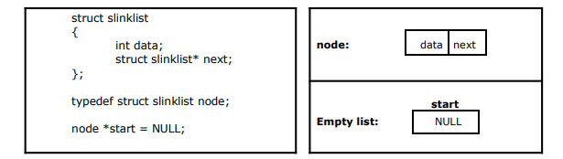
Implementation of Single Linked List
Create a start node to access the linked list.
Define a self-referential structure with data and a next pointer.
Initialize the start pointer to NULL.
Notes:
New Courses replaced with New Programmes

Slide 10
Traversal operation
Traversal is the process of visiting each node of the linked list exactly once to access or display data.
Traversal starts from head and continues until NULL.
Algorithm: Traverse Linked List
Start from head
If head is NULL, stop
Print the data of current node
Move to the next node
Repeat until current node becomes NULL
Notes:
New Courses replaced with New Programmes

Slide 11
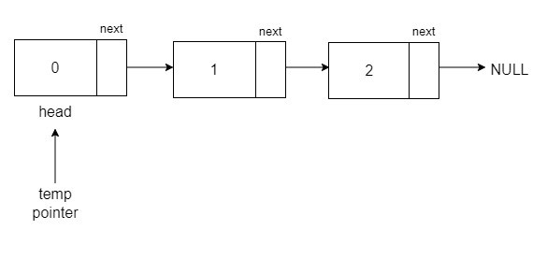
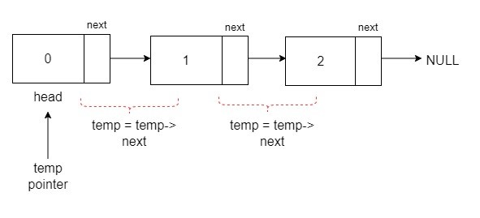
Algorithm
STEP 1: SET PTR = HEAD
STEP 2: IF PTR = NULL
WRITE "EMPTY LIST" GOTO STEP 7 END OF IF
STEP 4: REPEAT STEP 5 AND 6 UNTIL PTR != NULL
STEP 5: PRINT PTR→ DATA
STEP 6: PTR = PTR → NEXT
[END OF LOOP]
STEP 7: EXIT
Complete code here.
Notes:
New Courses replaced with New Programmes

Slide 12
Traversal Code
struct node *temp = head; printf("\n\nList elements are - \n");
while(temp != NULL) {
printf("%d --->",temp->data);
temp = temp->next; }
Notes:
New Courses replaced with New Programmes

Slide 13
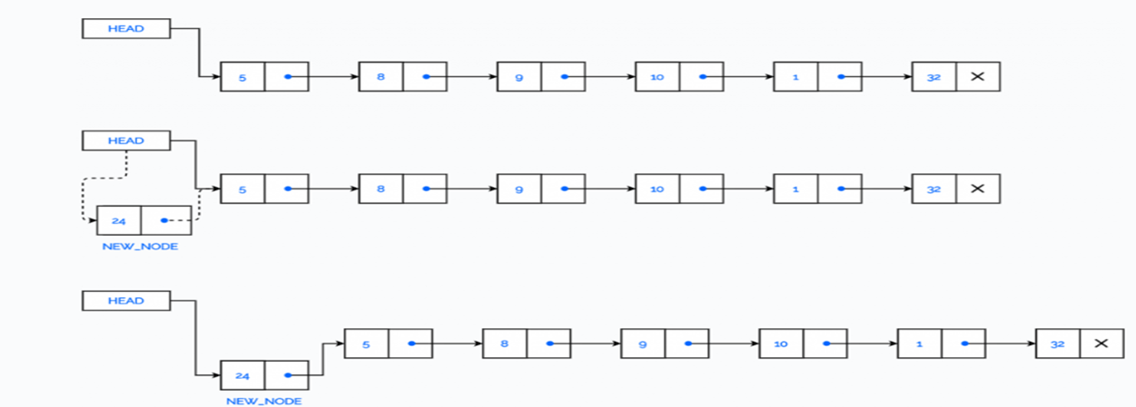
Insertion Operations at the beginning
Insertion at beginning means adding a new node before the current head.
Fastest insertion operation.
Notes:
New Courses replaced with New Programmes

Slide 14
Algorithm: Insert At Beginning
Step 1: IF AVAIL = NULL
Write OVERFLOW
Go to Step 7 [END OF IF]
Step 2: SET NEW_NODE = AVAIL
Step 3: SET AVAIL = AVAIL -> NEXT
Step 4: SET NEW_NODE -> DATA = VAL
Step 5: SET NEW_NODE -> NEXT = HEAD
Step 6: SET HEAD = NEW_NODE
Step 7: EXIT
Notes:
New Courses replaced with New Programmes

Slide 15
Insertion at beginning Code
def insert_begin(head, value):
new_node = Node(value)
new_node.next = head
return new_node
Notes:
New Courses replaced with New Programmes

Slide 16
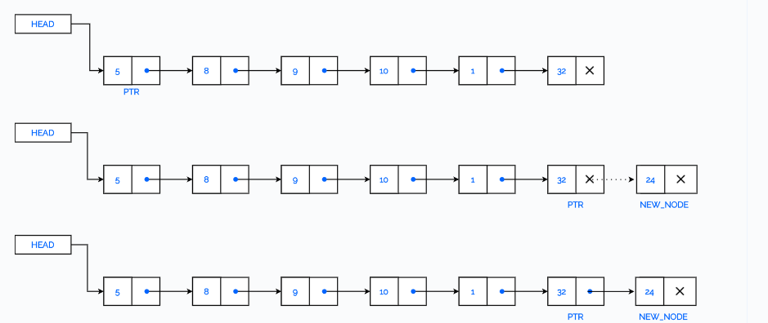
Insertion at End
Insertion at end means adding a new node after the last node.
Requires traversal.
Notes:
New Courses replaced with New Programmes

Slide 17
Algorithm: Insert At End
Step 1: IF AVAIL = NULL
Write OVERFLOW
Go to Step 10 [END OF IF]
Step 2: SET NEW_NODE = AVAIL
Step 3: SET AVAIL = AVAIL -> NEXT
Step 4: SET NEW_NODE -> DATA = VAL
Step 5: SET NEW_NODE -> NEXT = NULL
Step 6: SET PTR = HEAD
Step 7: Repeat Step 8 while PTR -> NEXT != NULL Step
Step 8: SET PTR = PTR -> NEXT [END OF LOOP]
Step 9: SET PTR -> NEXT = NEW_NODE
Step 10: EXIT
Notes:
New Courses replaced with New Programmes

Slide 18
Insertion at End Code
Insertion at End – Python Code
def insert_end(head, value): new_node = Node(value) if head is None: return new_node temp = head while temp.next: temp = temp.next temp.next = new_node return head
Notes:
New Courses replaced with New Programmes

Slide 19
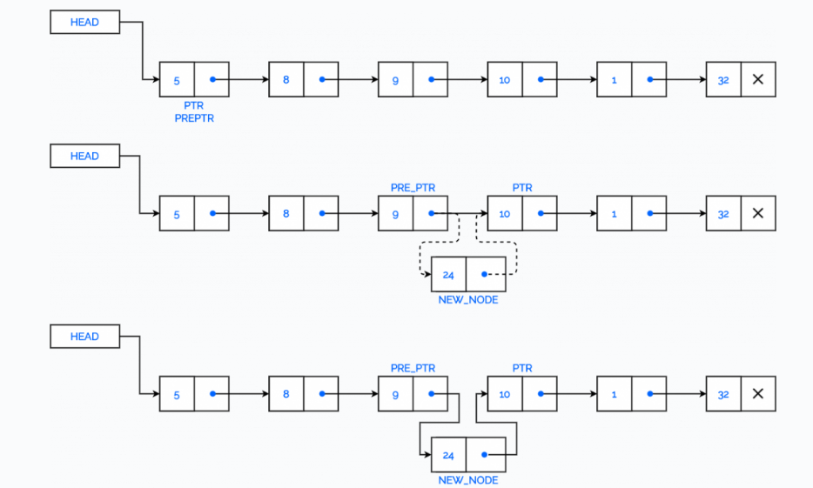
Insert a Node after a given Node in a Linked list
Notes:
New Courses replaced with New Programmes

Slide 20
Algorithm: Insert After An Element
Step 1: IF AVAIL = NULL Write OVERFLOW Go to Step 12 [END OF IF]
Step 2: SET NEW_NODE = AVAIL
Step 3: SET AVAIL = AVAIL -> NEXT
Step 4: SET NEW_NODE -> DATA = VAL
Step 5: SET PTR = HEAD
Step 6: SET PREPTR = PTR
Step 7: Repeat Steps 8 and 9 while PREPTR -> DATA != NUM
Step 8: SET PREPTR = PTR
Step 9: SET PTR = PTR -> NEXT [END OF LOOP]
Step 10 : PREPTR -> NEXT = NEW_NODE
Step 11: SET NEW_NODE -> NEXT = PTR
Step 12: EXIT
Notes:
New Courses replaced with New Programmes

Slide 21
Check Your Understanding
Traversal of a linked list always starts from the __________ node.
Insertion at the beginning of a linked list requires updating the __________ pointer.
Which insertion operation does not require traversal?
What will be the time complexity of inserting a node at the beginning of a linked list?
Notes:
New Courses replaced with New Programmes

Slide 22
Deleting Elements from a Linked List
The first node is deleted.
The last node is deleted.
The node after a given node is deleted
Notes:
New Courses replaced with New Programmes

Slide 23
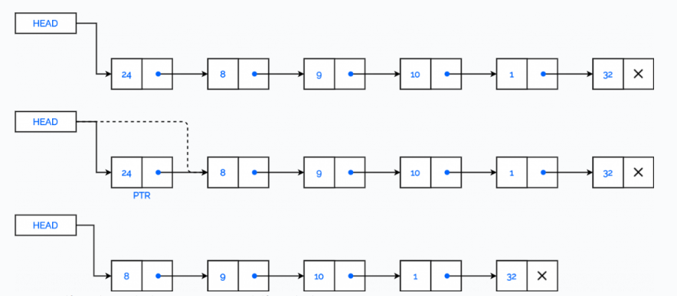
Deleting First Element from a Linked List
Deletion from beginning removes the first node of the linked list.
Notes:
New Courses replaced with New Programmes

Slide 24
Algorithm: Delete From Beginning
Step 1: IF HEAD = NULL
Write UNDERFLOW
Go to Step 5 [END OF IF]
Step 2: SET PTR = HEAD
Step 3: SET HEAD = HEAD -> NEXT
Step 4: FREE PTR
Step 5: EXIT
Notes:
New Courses replaced with New Programmes

Slide 25
Deletion from Beginning Code
Deletion from Beginning – Python Code
def delete_begin(head): if head is None: return None return head.next
Notes:
New Courses replaced with New Programmes

Slide 26
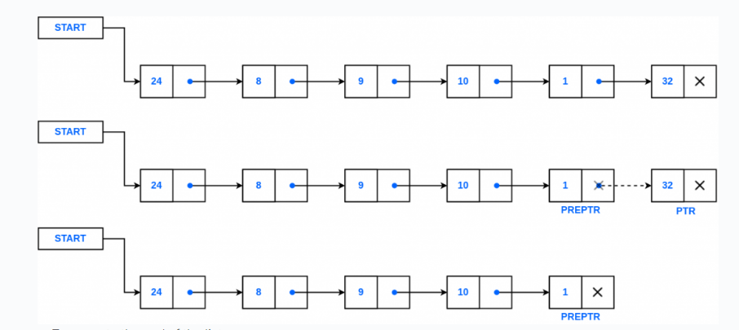
Deletion from End of a Linked list
Deletion from end removes the last node of the linked list.
Notes:
New Courses replaced with New Programmes

Slide 27
Algorithm: Delete From End
Step 1: IF HEAD = NULL Write UNDERFLOW Go to Step 8 [END OF IF]
Step 2: SET PTR = HEAD
Step 3: Repeat Steps 4 and 5 while PTR -> NEXT != NULL
Step 4: SET PREPTR = PTR
Step 5: SET PTR = PTR -> NEXT [END OF LOOP]
Step 6: SET PREPTR -> NEXT = NULL
Step 7: FREE PTR
Step 8: EXIT
Notes:
New Courses replaced with New Programmes

Slide 28
Deletion from End Code
Deletion from End – Python Code
def delete_end(head): if head is None or head.next is None: return None temp = head while temp.next.next: temp = temp.next temp.next = None return head
Notes:
New Courses replaced with New Programmes

Slide 29
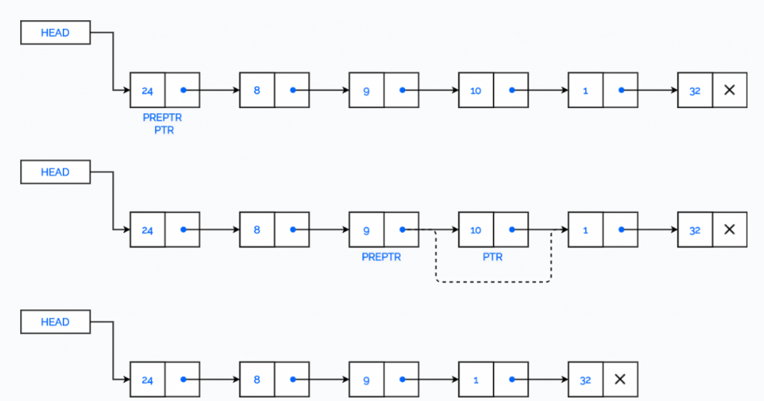
Delete the Node after a given Node
Notes:
New Courses replaced with New Programmes

Slide 30
Algorithm: Delete After A Node
Step 1: IF HEAD = NULL Write UNDERFLOW Go to Step 10 [END OF IF]
Step 2: SET PTR = HEAD
Step 3: SET PREPTR = PTR
Step 4: Repeat Steps 5 and 6 while PREPTR -> DATA != NUM
Step 5: SET PREPTR = PTR
Step 6: SET PTR = PTR -> NEXT [END OF LOOP]
Step 7: SET TEMP = PTR
Step 8: SET PREPTR -> NEXT = PTR -> NEXT
Step 9: FREE TEMP
Step 10 : EXIT
Notes:
New Courses replaced with New Programmes

Slide 31
Code
void del(node *before_del)
{
if (before_del == NULL || before_del->next == NULL)
return;
node* temp = before_del->next;
before_del->next = temp->next;
delete temp;
}
Complete code here
Notes:
New Courses replaced with New Programmes

Slide 32
Check Your Understanding
Which node is removed during deletion from the beginning of a linked list?
Deletion from the end of a singly linked list requires locating the __________ node.
What happens if deletion is attempted on an empty linked list?
What is the time complexity of deleting the last node in a singly linked list?
Notes:
New Courses replaced with New Programmes

Slide 33
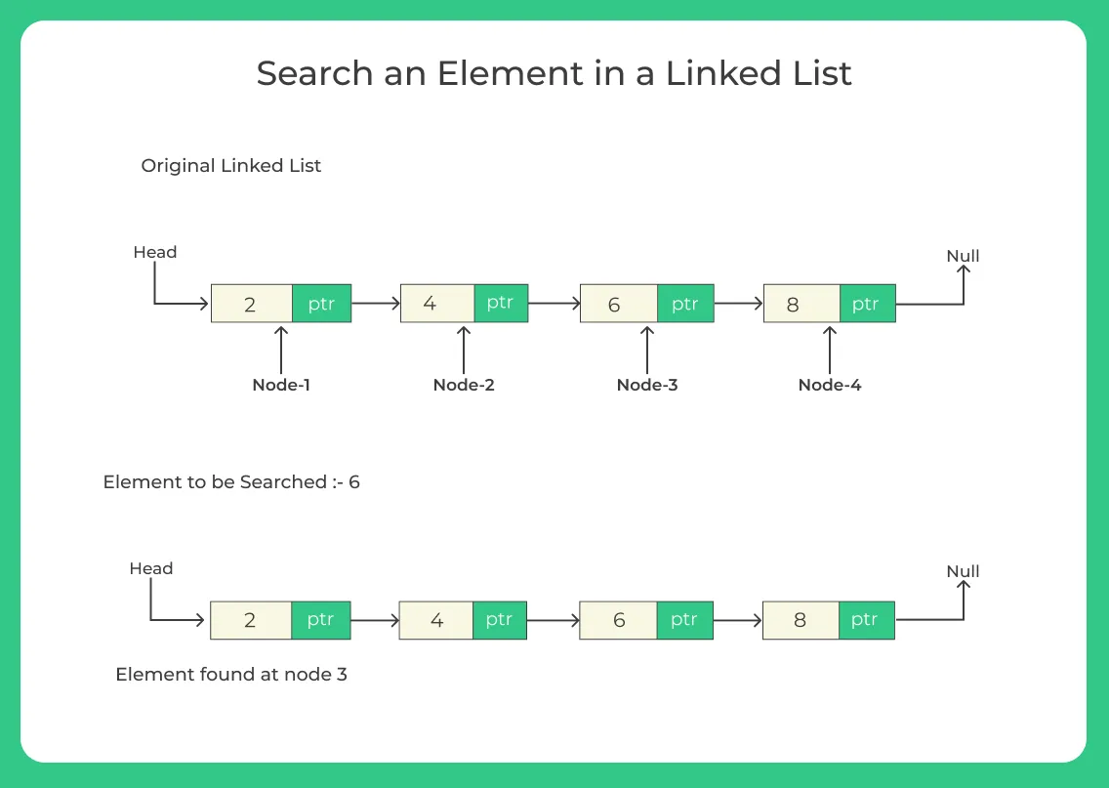
Search (Algorithm)
Step 1: [INITIALIZE] SET PTR = HEAD
Step 2: Repeat Steps 3 and 4 while PTR != NULL
Step 3: If ITEM = PTR -> DATA SET POS = PTR Go To Step 5 ELSE SET PTR = PTR -> NEXT [END OF IF] [END OF LOOP]
Step 4: SET POS = NULL
Step 5: EXIT
Notes:
New Courses replaced with New Programmes

Slide 34
Advantages and disadvantages
Advantages | Disadvantages
Efficient insertion and deletion: Only pointer adjustments are needed. Dynamic size: List can grow or shrink without contiguous memory. Flexible: No fixed size limit for data storage. | No direct access: Elements must be accessed by traversing from the head. Extra memory overhead: Each node stores an additional pointer. Inefficient reverse traversal: No backward pointers in singly linked lists.
Notes:
New Courses replaced with New Programmes

Slide 35
Test Yourself
A linked list is made up of a collection of __________.
The pointer to the first node of a linked list is called the __________.
In a singly linked list, the last node points to __________.
Traversal of a linked list starts from the __________ node.
Insertion at the beginning of a linked list has time complexity __________.
Notes:
New Courses replaced with New Programmes

Slide 36
Key Takeaways
Linked list operations rely heavily on pointer manipulation
Traversal is required to access or modify most nodes
Insertion and deletion at the beginning are the fastest operations
Deletion and insertion at the end require traversal
Proper handling of head and NULL conditions is critical
Notes:
New Courses replaced with New Programmes

Slide 37
References
Textbooks
Cormen, T. H., Leiserson, C. E., Rivest, R. L., & Stein, C., Introduction to Algorithms, MIT Press.
Lipschutz, S., Schaum’s Outline of Data Structures with C++, McGraw-Hill Education.
Reference Books
Weiss, M. A., Data Structures and Algorithm Analysis in C++, 5th Edition, Pearson Education.
Skiena, S. S., The Algorithm Design Manual, 3rd Edition, Springer.
Online Resources
GeeksforGeeks – Linked List Operations https://www.geeksforgeeks.org/linked-list-set-1-introduction/
GeeksforGeeks – Insertion & Deletion in Linked List https://www.geeksforgeeks.org/linked-list-set-2-inserting-a-node/
TutorialsPoint – Linked List Operations https://www.tutorialspoint.com/data_structures_algorithms/linked_list_algorithms.htm
Programiz – Linked List in Python https://www.programiz.com/dsa/linked-list
MIT OpenCourseWare – Introduction to Algorithms https://ocw.mit.edu
Notes:
New Courses replaced with New Programmes

Slide 38
THANK YOU

